Slide 2
111
UZr MEAM 800 K
100
110

Slide 3
111
UZr MEAM 1000 K
100
110

Slide 4
111
ADP 800 K
100
110

Slide 5
111
ADP 1000 K
100
110

Slide 6
111
U MEAM 800 K
100
110

Slide 7
111
U MEAM 1000 K
100
110

Slide 8
111
111
111
100
110
100
110
100
110
U MEAM
UZr MEAM
UMo ADP

Slide 9
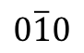
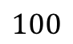
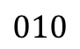
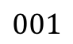
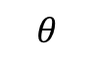
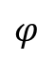
$$010$$
90
$$100$$
$$φ$$
$$001$$
$$0\overline{1}0$$
-90
90
$$θ$$

